Slide 1



Biogas Capture and Upgrading Technology
Joe Ayala
GM Puregas, North America
Renewable Gases, North America

Slide 2
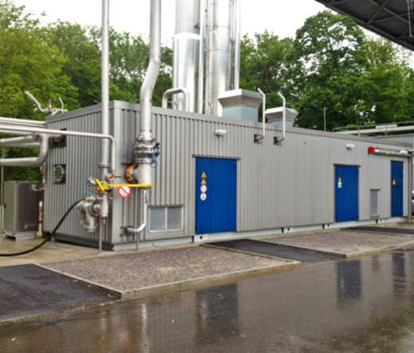
Wärtsilä gas solutions/
Puregas solutions
BIOGAS UPGRADING/ capure technology
September 2020
Joe Ayala
GM Puregas, North America
Renawable Gases, North America

Slide 3
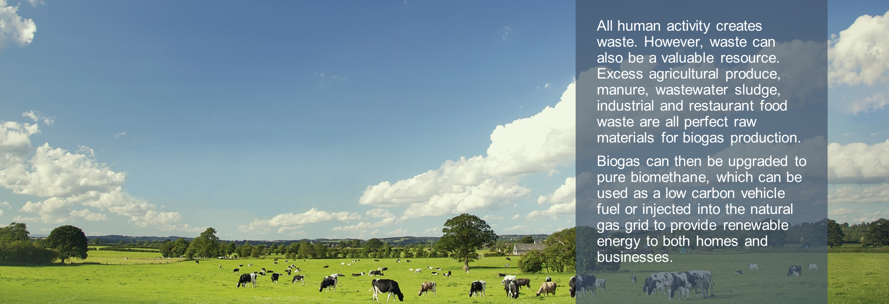
biogas

Slide 4
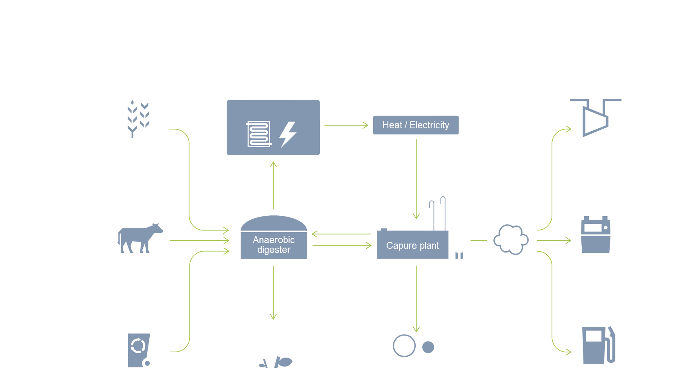
Biogas process

Slide 5
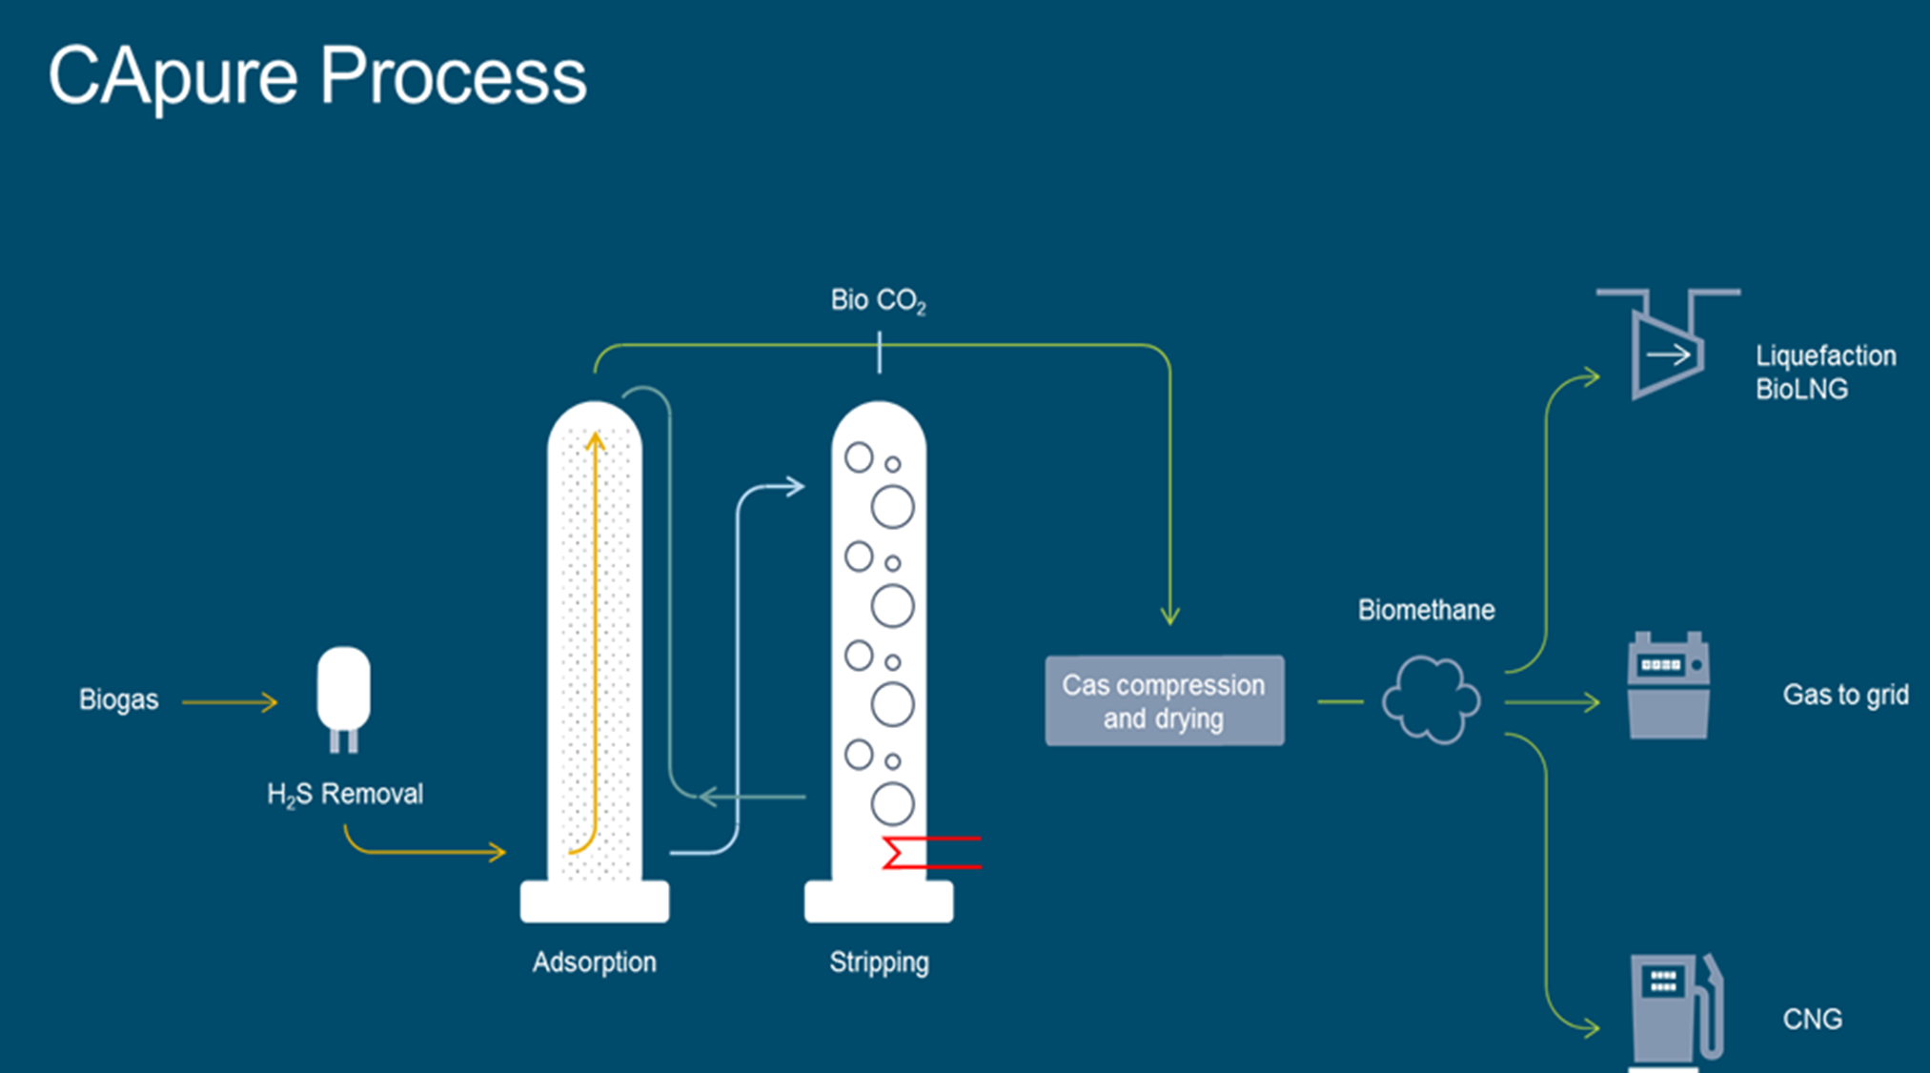
Capure process
1
2
3
4
5

Slide 6
Capure process
The CApure technology is a process for removal of carbon dioxide from biogas.
This is done by a chemical absorption process as CO₂ reacts with the CApure liquid. The CApure liquid is a special amine composition designed for CO₂ removal mixed with 50 % high purity water and is re-circulated in a completely closed system.
Biogas from an AD (biogas production) plant is delivered to the CApure biogas upgrading plant.
The biogas enters a H₂S vessel filled with activated carbon for removal of up to 300 ppm of H₂S.
H₂S reacts with O₂ resulting in formation of H₂O and elementary sulphur (S₈).
The biogas enters the absorption column from the bottom and flows upwards. The CApure liquid enters the column from the top and flows downwards and meets raw gas. The column is filled with surface enlarging packing to give a large contact surface between the biogas and the CApure liquid. The chemical absorption process takes place as the biogas meets the CApure liquid. The upgraded biogas leaves the column from the top and the CO₂ enriched CApure liquid at the bottom.
The enriched CApure liquid is pumped to the stripper column for desorption of the CO₂ by heating to the boiling point. The CApure liquid enters the stripper column from the top and flows downwards through surface enlarging packages. The CO₂ leaves the stripper column from the top.
The upgraded biogas (biomethane) is compressed and dried.

Slide 7
Why choose capure
Maximum Methane Recovery
Maximise revenue, fully exploit incentives
Minimum Methane Slip – <0,1% GUARANTEED
Protecting the environment, achieving sustainability criteria
Highest Methane Purity
Meets pipeline specification, minimise CV enrichment (propane)
Lowest Cost of Ownership
CAPEX/OPEX utility consumption, uptime, service/maintenance
Product Range Flexibility
Wide range of flow capacities, able to adjust to differing flows
13 million compressed natural gas vehicles worldwide.

Slide 8
Why choose capure
Highest Build Quality and Design
Reliability, long service life, ease of use
Comprehensive Service Support
Maximise plant availability, local expertise, plant optimisation
Additional Revenue Stream Possibilities
Crop propagation, CO₂ recovery, bioCNG and bioLNG production
Ease of Operation
Automated process, plc controlled
Extensive Reference List
3rd party referrals provide peace-of-mind, multiple AD technologies and feedstocks
Over 30 plants already operational across Europe.

Slide 9
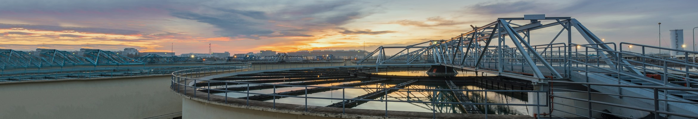
99,9% methane recovery
99.9% of the CH₄ in the biogas can be sold
Always the highest revenue
CApure Technology
No affinity for CH₄ / high affinity for CO₂
Best In Class
No other single technology achieves
this efficiency

Slide 10
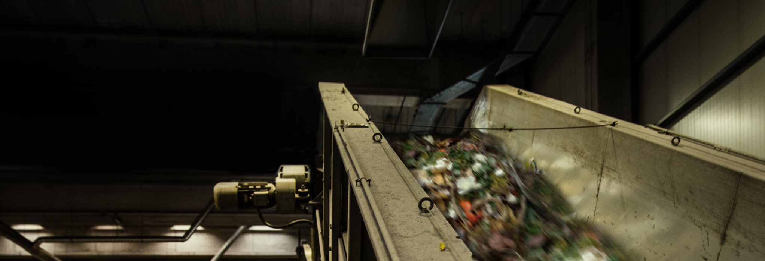
<0,1% methane slip
Minimises GHG emissions
Helps achieve sustainability criteria
CO₂ can be used directly for crop propagation
No need for additional exhaust treatment
Easier to recover CO₂ for Food Grade applications

Slide 11
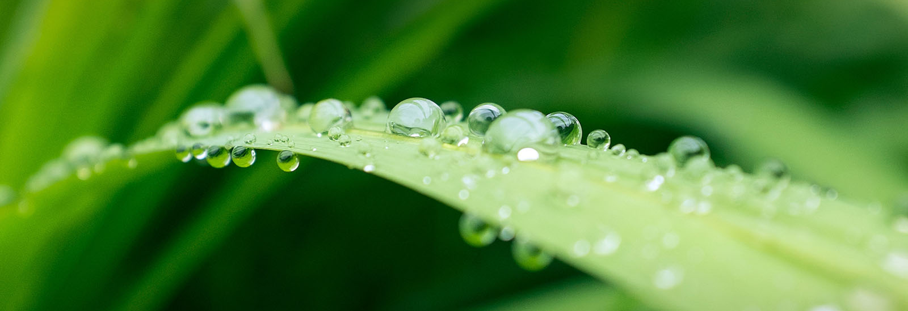
Up to 99% CH4 purity
Meets pipeline specification
Lower purity requirements can be achieved by blending
Reduced requirement for propane enrichment
Significant cost saving

Slide 12
Lowest cost of ownership
< 0.06 kWh/Nm³ Biogas in electricity consumption
  CApure process operates at low pressure (only the CH₄ is compressed)
< 0.1 kWh/Nm³ Biogas in net heat consumption
  80% of the heat used can be recovered
Low consumption of water and solvents
  Long life, biodegradable organic solvents used in CApure process
  are part of a closed-loop system
Low maintenance cost
  Robust design, Easy access, 98% uptime guaranteed
Recovered by
Puregas Solutions unique upgrading process.

Slide 13
Extensive product range
Core model | Max Capacity (scfm)
CA30 | 400
CA50 | 780
CA60 | 1200
CA70 | 1750
CA80 | 3600
5 core models - available in 3 versions
Standard
Vacuum models for lower temperature requirement
LBG models (to avoid pre-treatment before liquefaction)

Slide 14
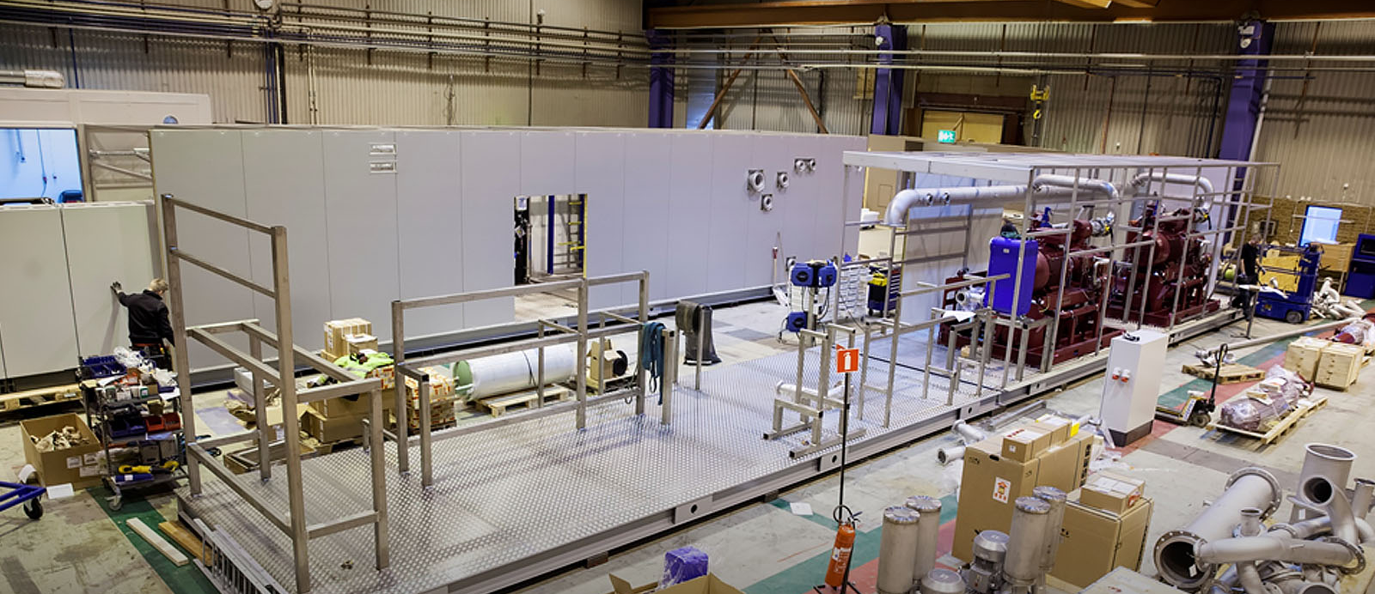
HIGHEST BUIlD QUALITY AND DESIGN
Manufactured and fully tested before delivered to site
High-Grade Stainless Steel used throughout
Built-in redundancy of key components such as compressors and blowers
Easy access for maintenance
US manufactured in Dubuque, Iowa

Slide 15
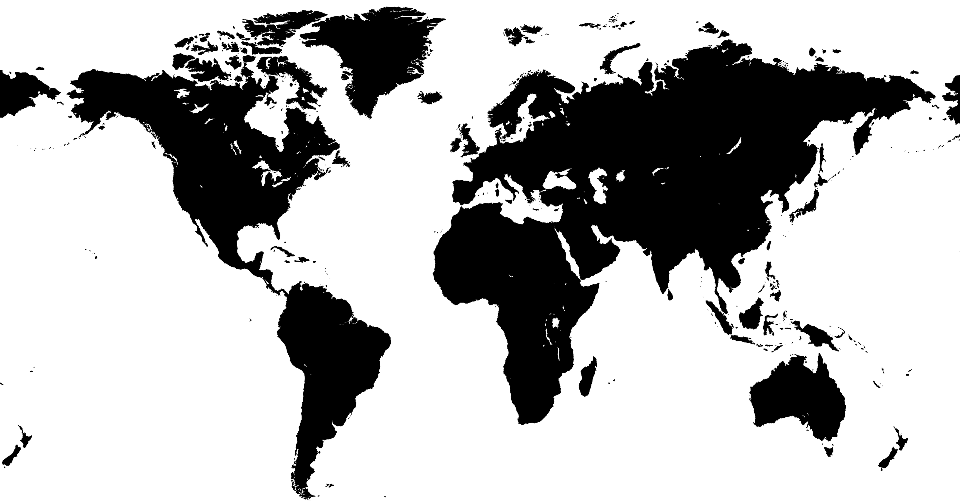

Capure manufacturing footprint
Kalmar, Sweden
HQ & Main Workshop
Dubuque, USA

Slide 16
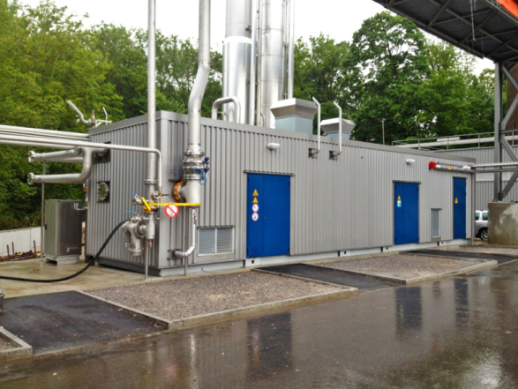
Operations excellence
No need for pre-treatment
CApure removes VOCs Siloxanes H₂S
No need to flare upgraded gas
CApure re-circulates out of spec gas
No need for site supervision
CApure is a fully automated process
Proven Technology
Amine widely used in gas processing
Easy access for maintenance
Access for maintenance is a design criteria

Slide 17
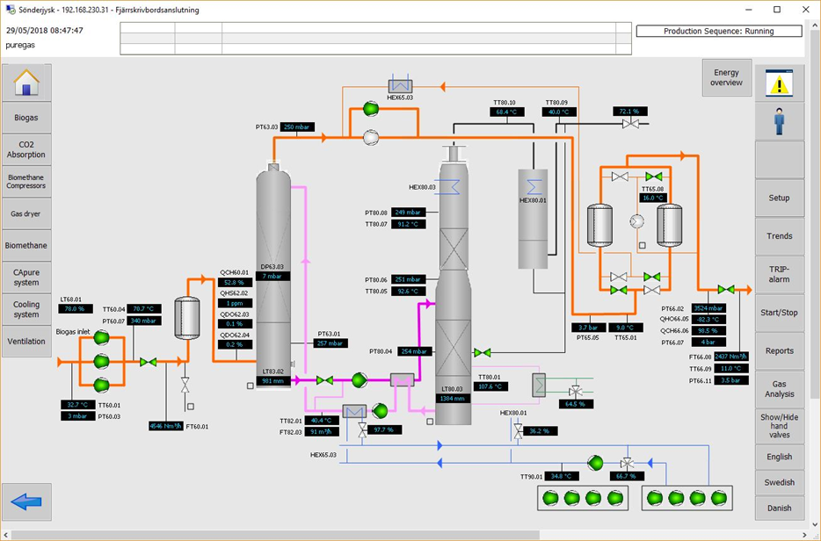
COMprehensive service support
Packages include remote operation, supervision, control, service, maintenance & 24/7 phone support
Installation, Start-Up, Commissioning and Operator Training included as standard
Extended warranty packages available
Remote monitoring and call out available
98% uptime guarantee - further improved through optimisation program

Slide 18
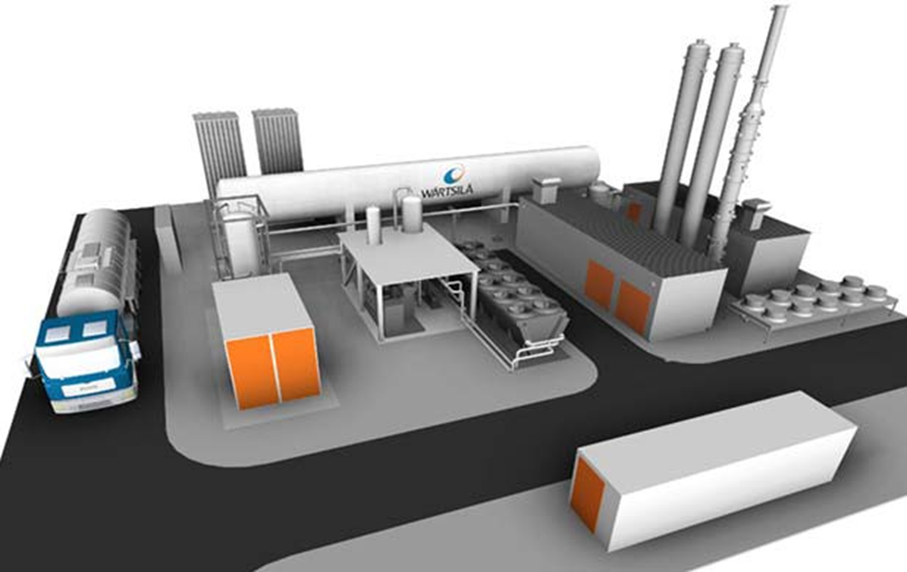
Integrated lbg (liquEfied biogas) offer
Historically
New
WS/
Membrane
2nd Polishing step
Liquefaction
CApure
MR
Liquefaction
Integrated solution
CApure biogas upgrading
MR biomethane liquefaction

Slide 19
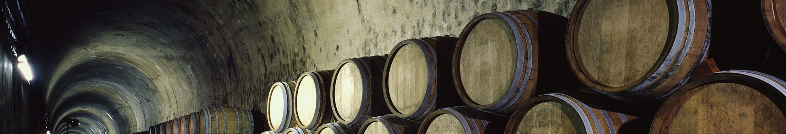
Extensive reference list
Over 40 operational sites
Sites in USA, Sweden, UK, Denmark, Germany, Norway, Ireland, Switzerland
Two new installations in US in 2019/2020
Range of substrates including food waste, agricultural residues, green crops, WWTP

Slide 20
Wartsila North america
Thanks for your interest
in our technology

